Slide 1
Problem Statement:
1) Best row was formed on coverlsip line/smudged annotation.
Description:
1) Based on the class information for some of the slides, we estimated our coverslip line as best row.
2) Category information was estimated from k-means from NLMD.
2)a) Class information was relative to each slide, meaning Classes for each slide clustered based on thier features using k-means.
3) During best row estimation, equal weight were given for class 1 and class 2.

Slide 2
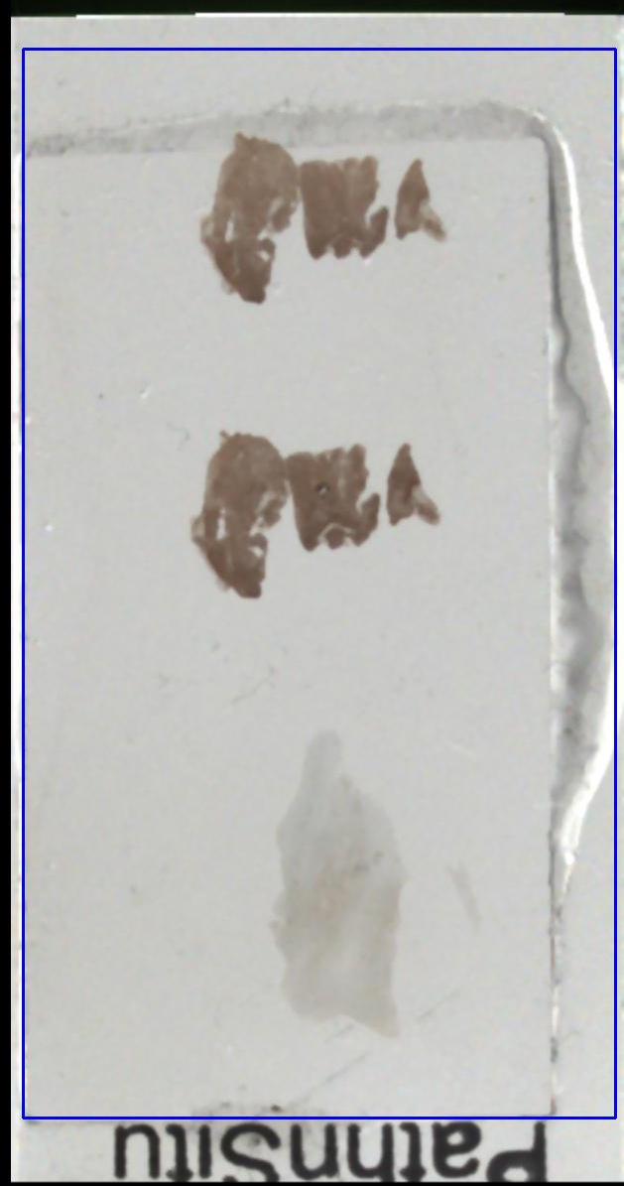
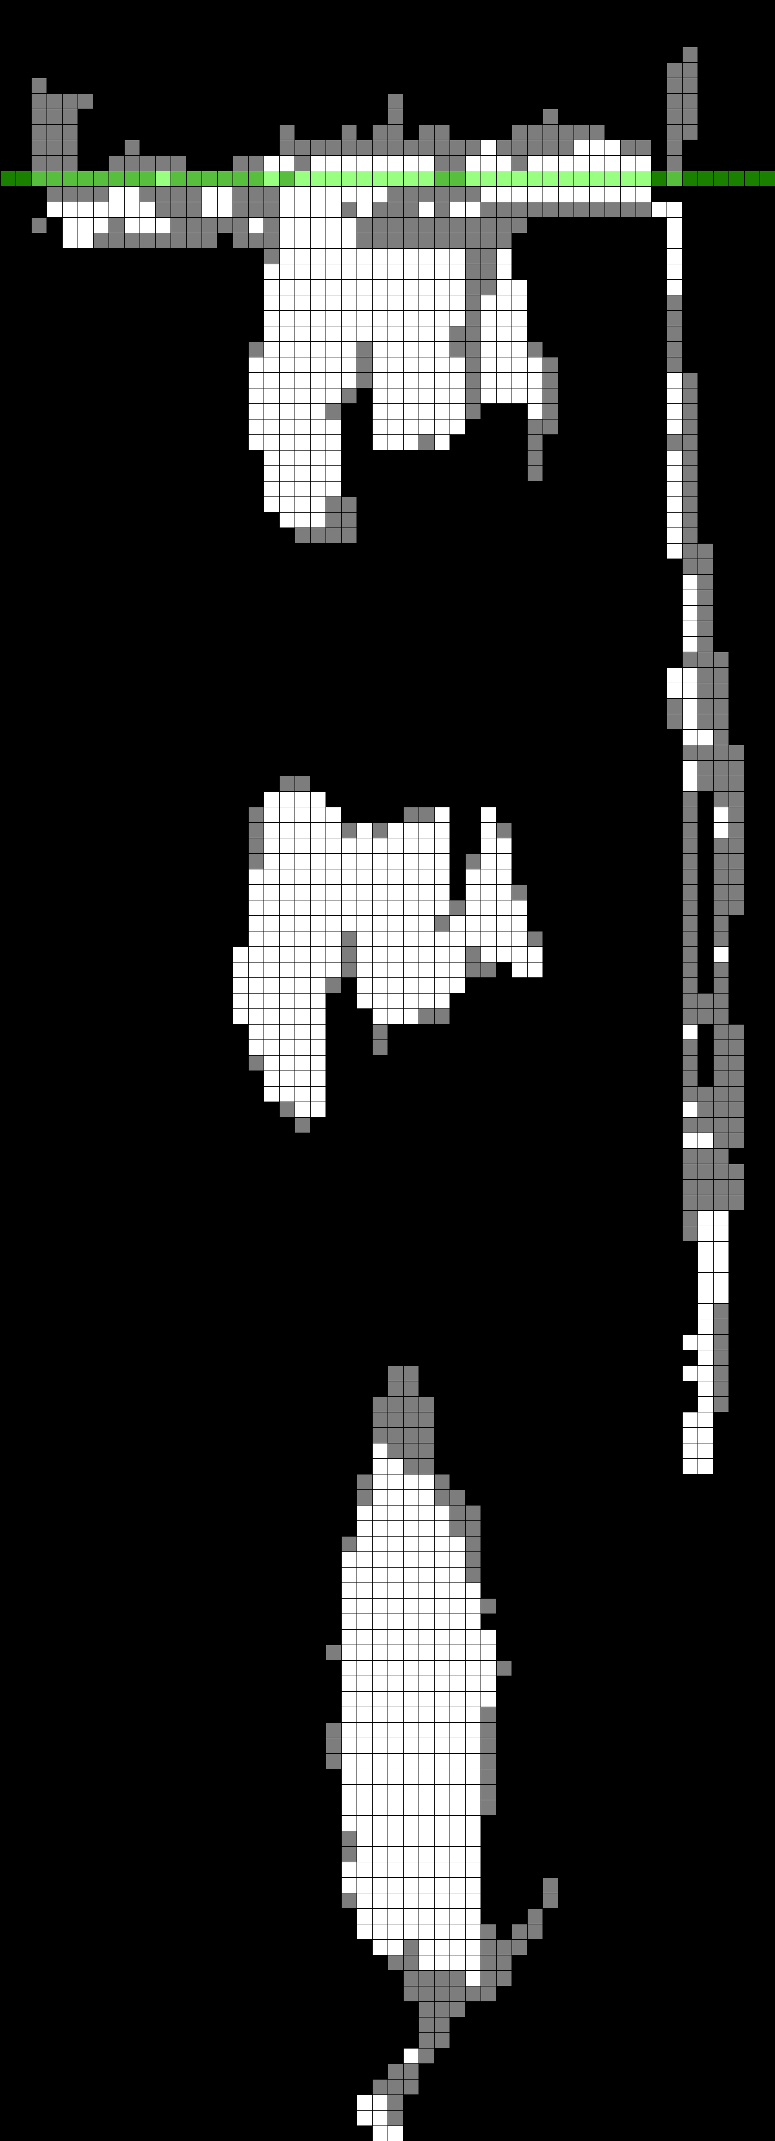
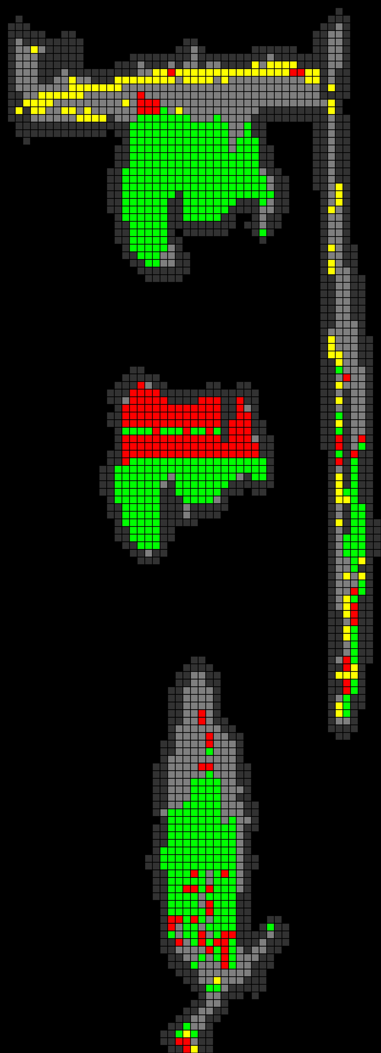
Best Row selection :
Following are the possibilities where best row is estimated on the coverslip
Case 1 : Tissue touching the coverslip and tissue is out of Focus.
Case 2 : Tissue is touching the coverslip and tissue is not out of Focus. In this case partial tissue is outside the coverslip (H01CBA05P_39089)
Case 1
Case 1
Case 1
Bbox Image
Estimated Best Row
Focus Error Map

Slide 3
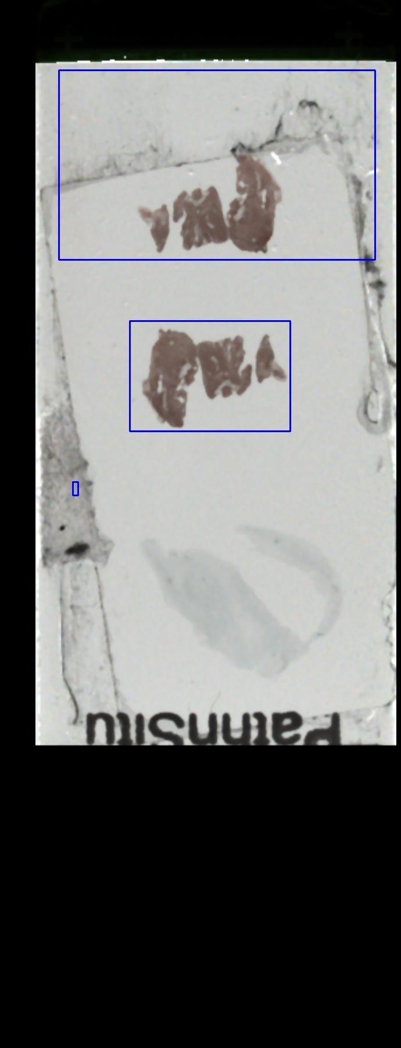
Case 1 (H01CBA04R_30392) For this Slide, due to best row being on coverslip region, it affected our acquitision.
Case 1
Case 1
Case 1
Bbox Image
Estimated Best Row
Focus Error Map

Slide 4
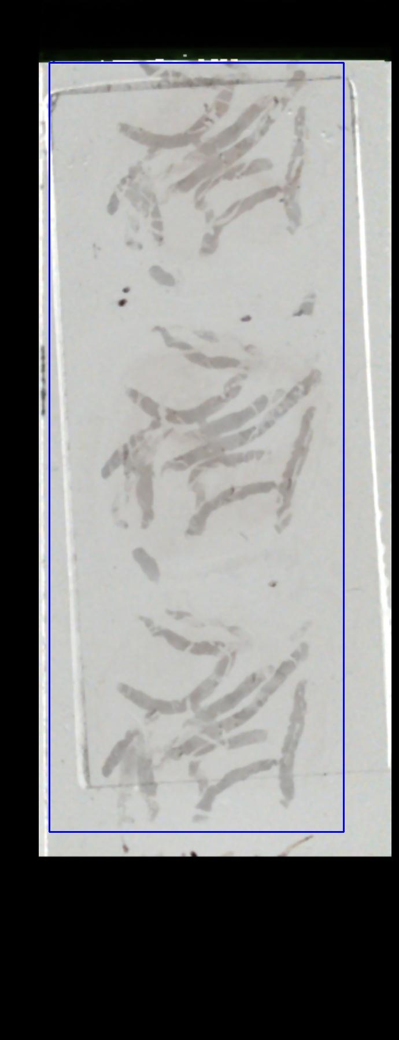
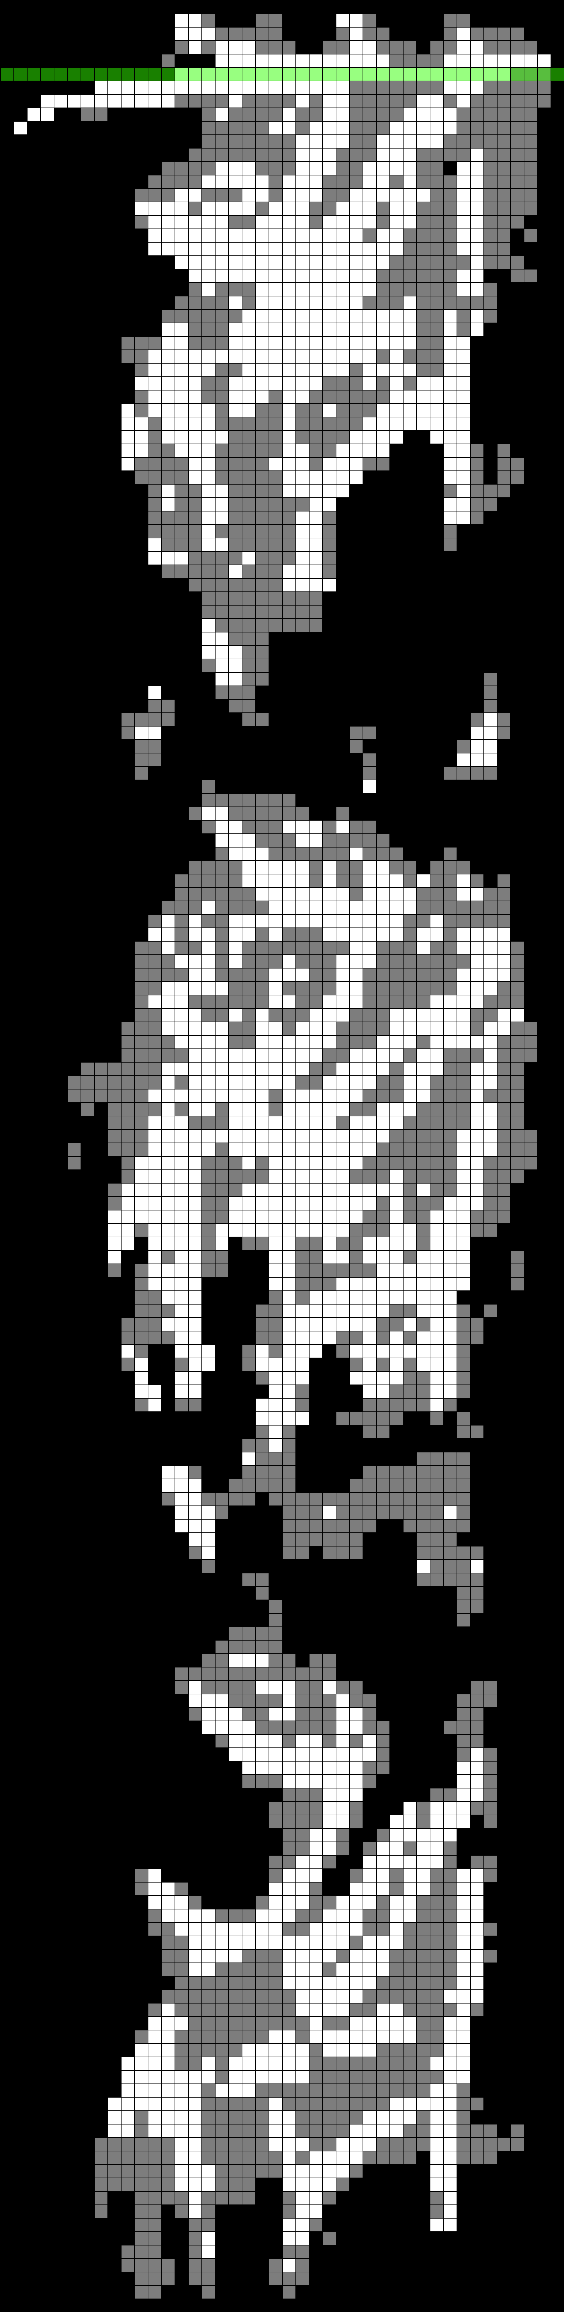
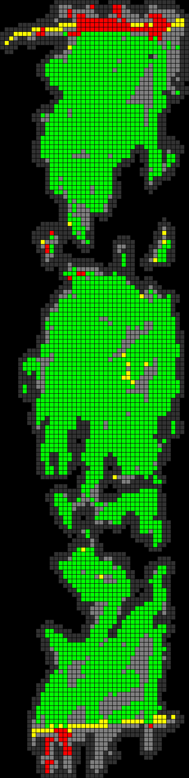
Case 2 : (H01CBA04R_23934)
Tissue is touching the coverslip and tissue is not out of Focus (H01CBA04R_23934).
Case 2
Case 2
Case 2
Bbox Image
Estimated Best Row
Focus Error Map

Slide 5
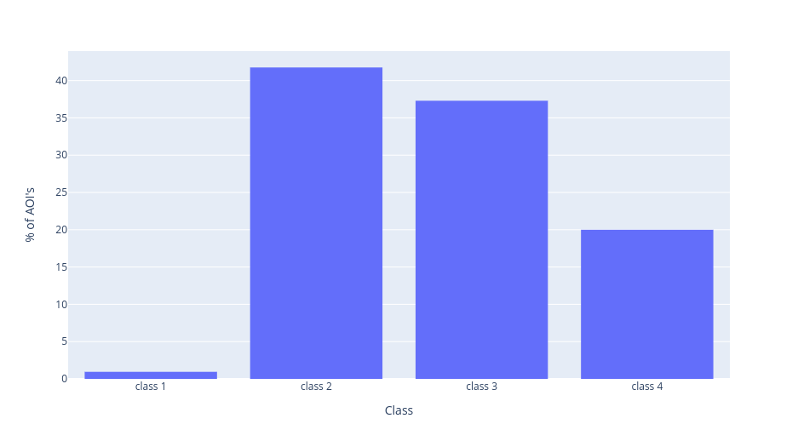
On further analysis,
Distribution of Class for Coverslip Regions
Coverslip Class Distribution
Dataset used was composed of slides where grids were over the coverslip region.
AIM of this experiment was to identify above mentioned regions and their corresponding classes.
As, we can see that, most of the AOI's in coveslip falls in classes 2,3 and 4.
A solution for solving best row falling on coverslip region is to seperate out class1 and class2.
Give class2 lower priority than class1.
Lowering priority of class2 could lead to problems as well, because faint Non-H&E slides will have class distribution fairly on classes 2,3&4. Examples :

Slide 6
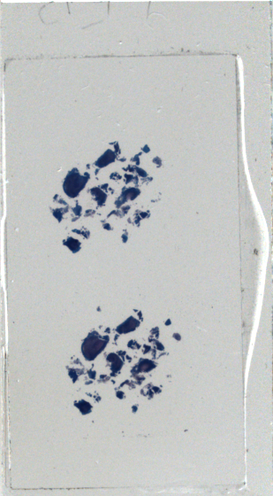
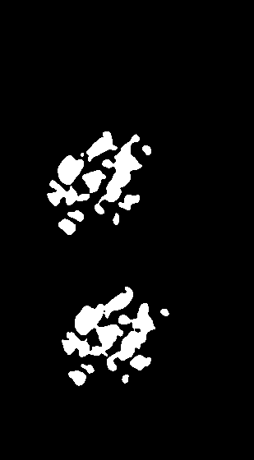
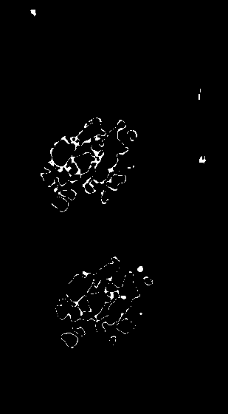
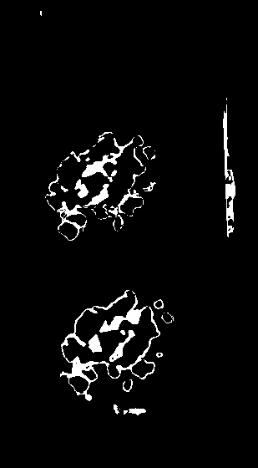
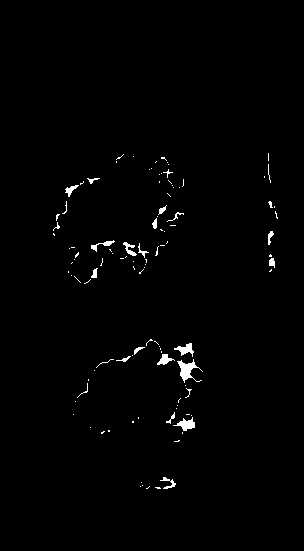
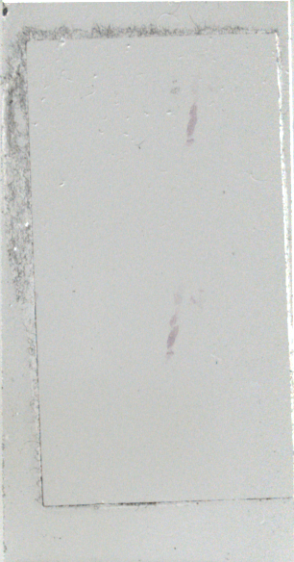
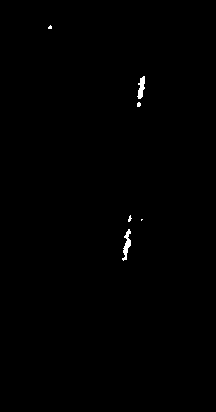
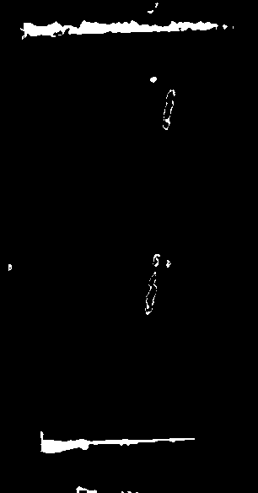
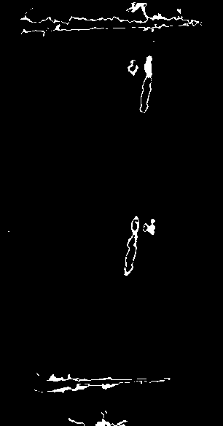
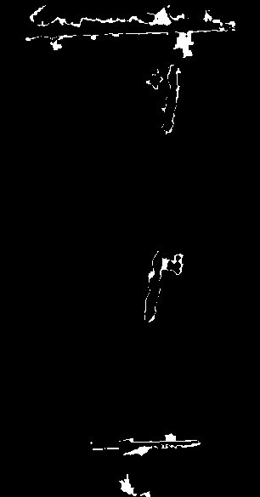
 | Class 1 | Class 2 | Class 3 | Class 4
H01CBA05P_39021
Coverslip Line
PPP5246

Slide 7
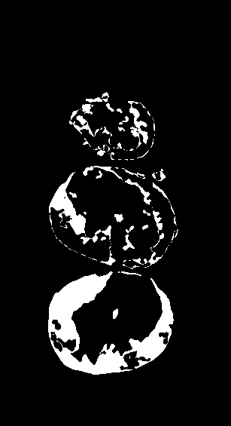
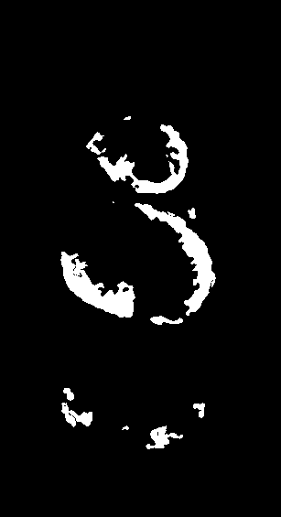
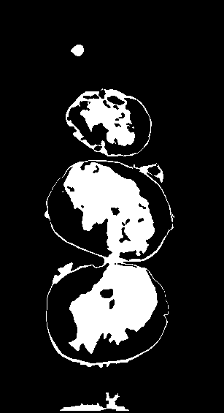
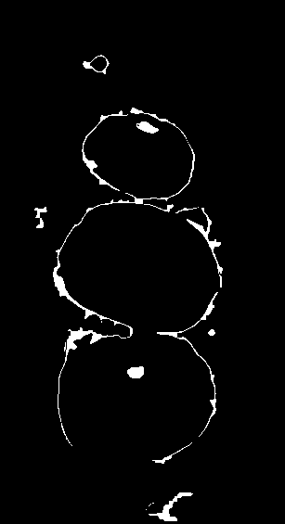
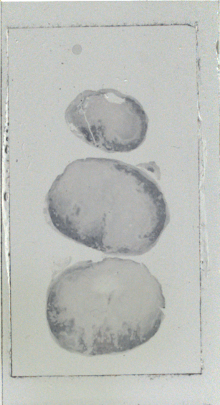
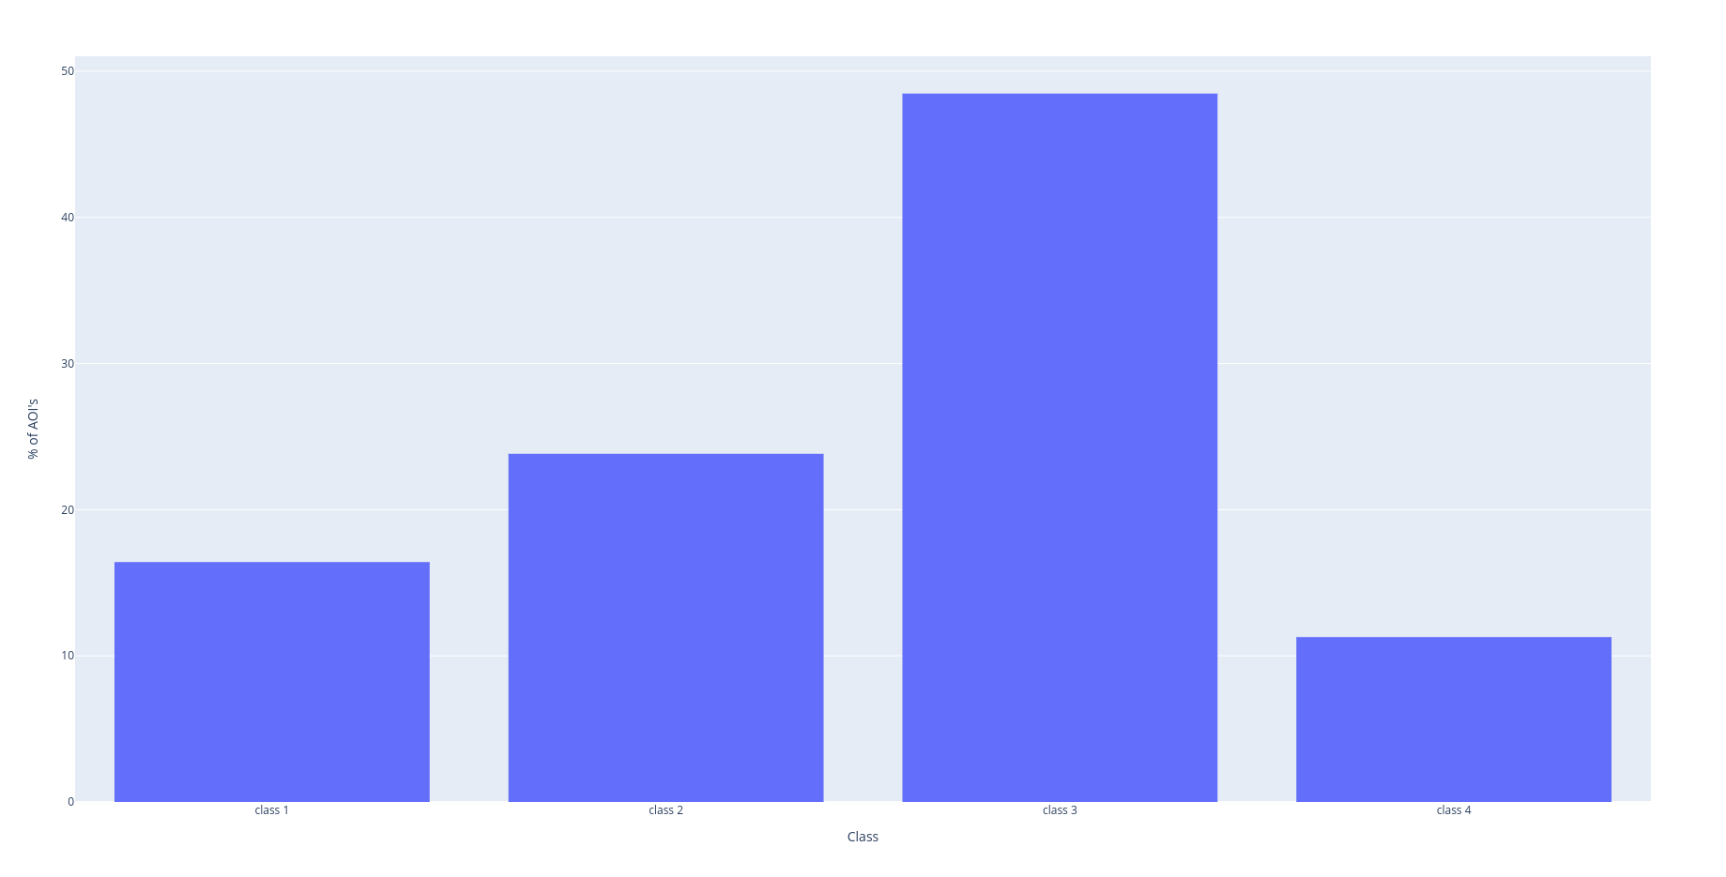
Class 1
Class 2
Class 3
Class 4
H01CBA05P_23719

Slide 8
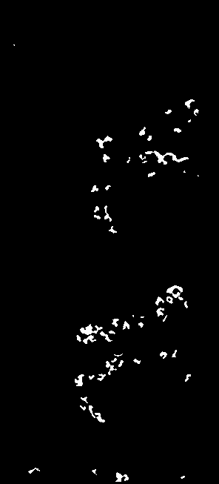
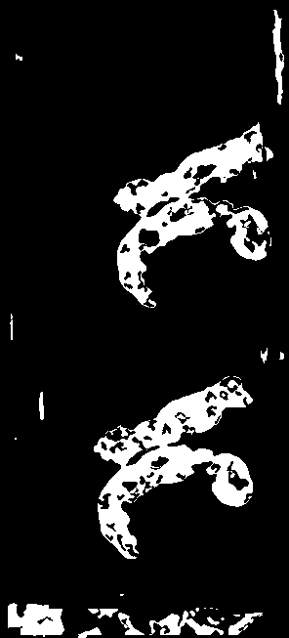
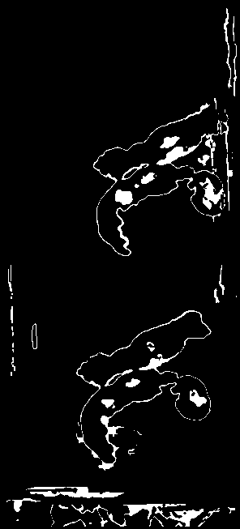
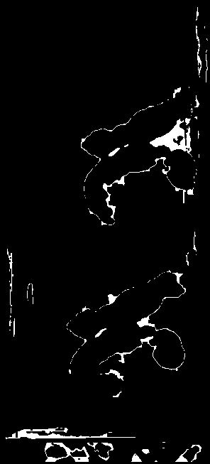
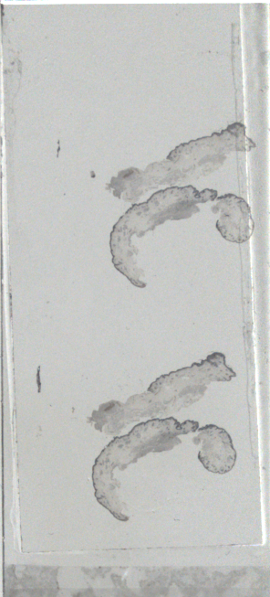
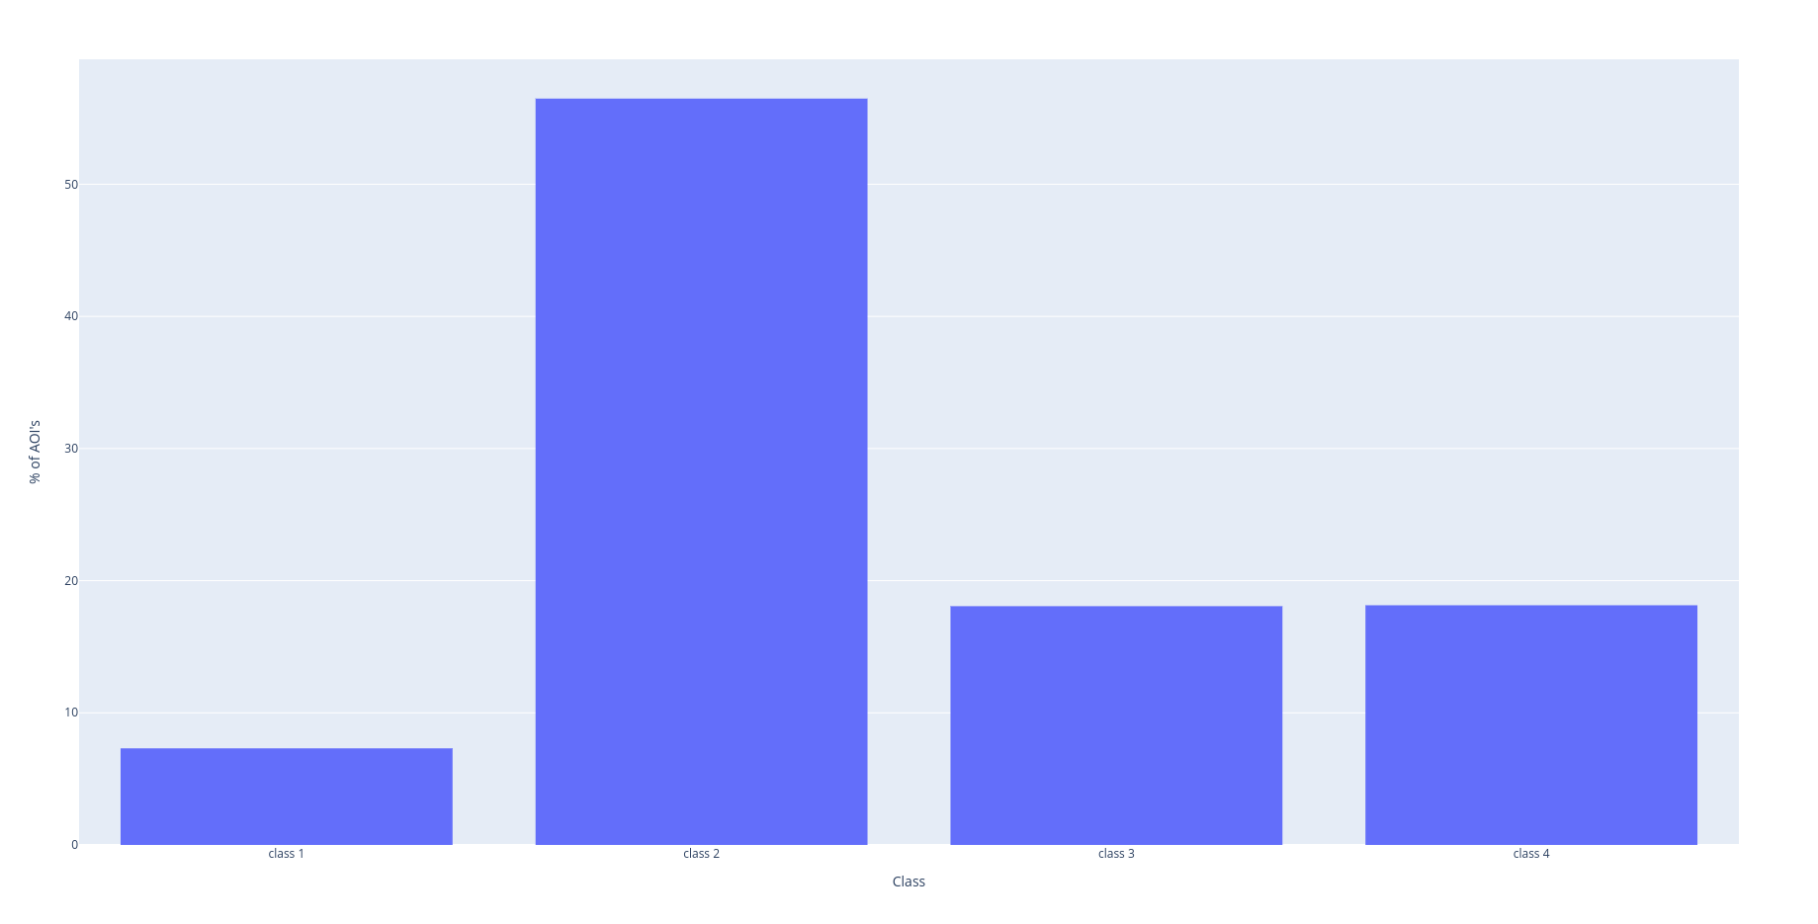
Class 1
Class 2
Class 3
Class 4
H01CBA05P_28718

Slide 9
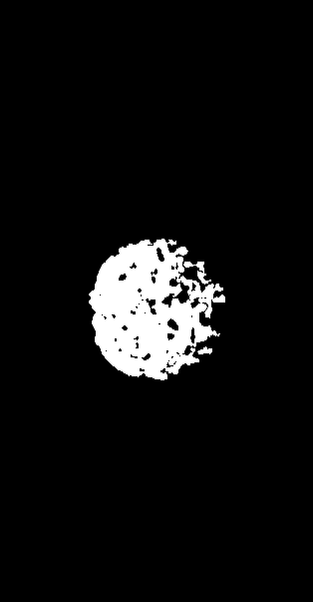
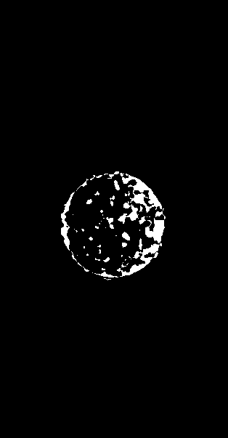


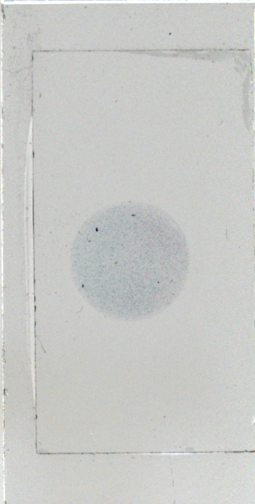
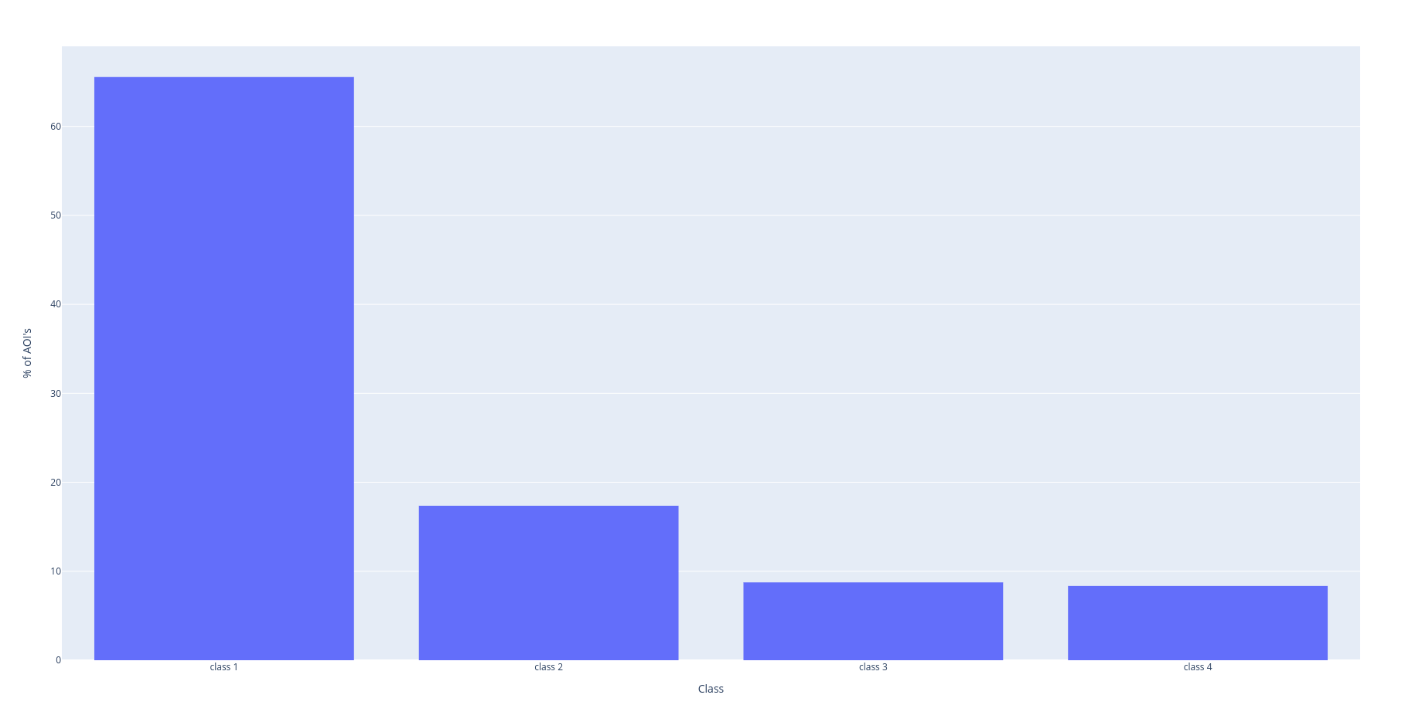
Class 1
Class 2
Class 3
Class 4
H01CBA04R_23952

Slide 10
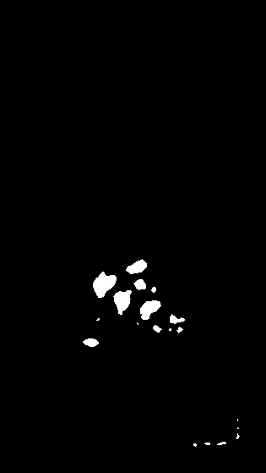
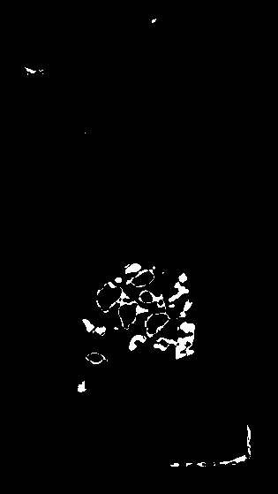
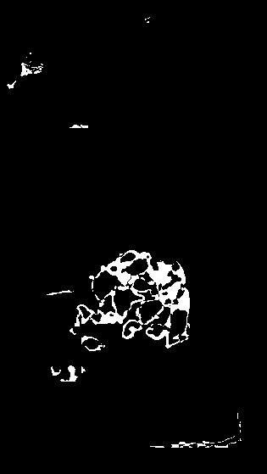
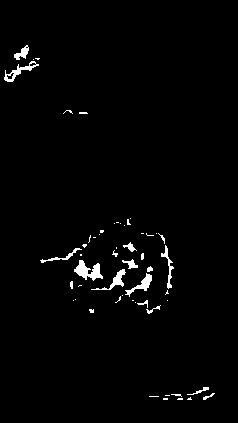
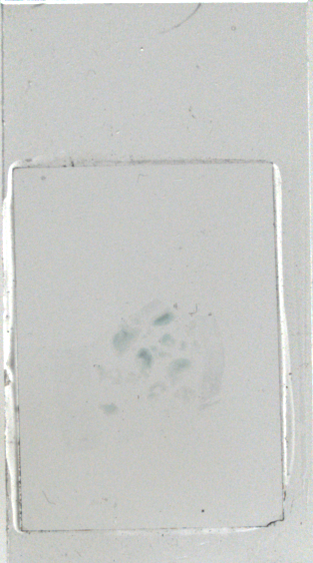
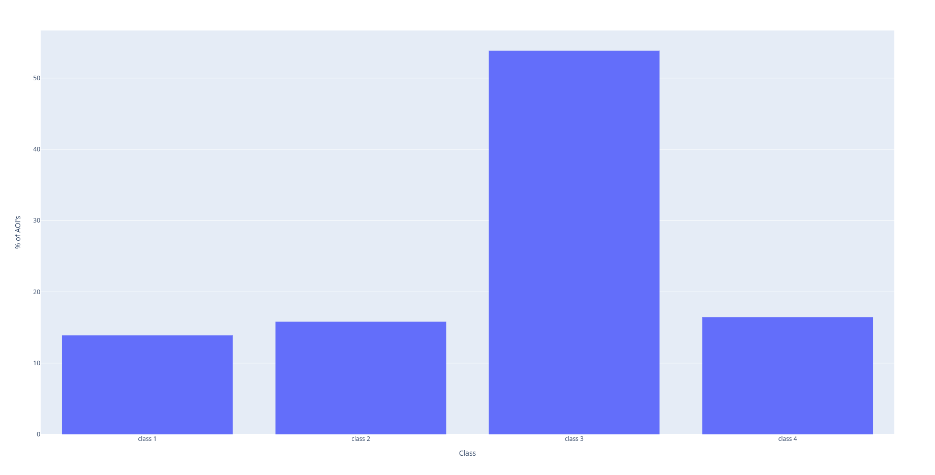
Class 1
Class 2
Class 3
Class 4
H01CBA04R_24008

Slide 11
Summary
Combining Class 1 and Class 2 information to estimate best row resulted in cases wherein our Biopsy was touching coverslip line.
Suggestions:
Weights for best row selection should be re-evaluated statistically.

